Slide 1
ADK 101
Amir Lazarovich and Uri Shaked
amirlazarovich@gmail.com / uri@salsa4fun.co.il
Reversim Summit 2013

Slide 2
What we will cover
What is ADK?
Inspirations
Live demo
Android-ADK simple communication protocol
1 minute about resistors and LEDs
Setting up the technical environment
Lab outline
Coding!

Slide 3
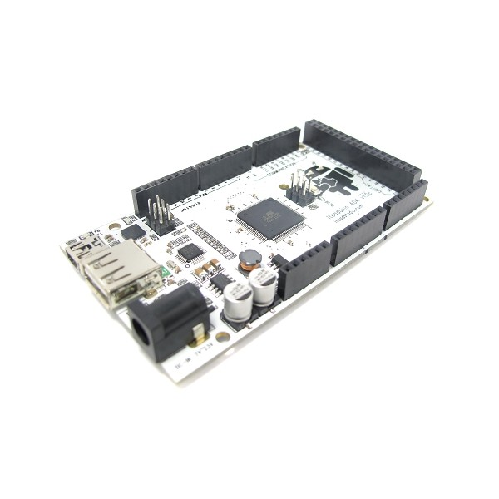

What is a Accessory Development Kit?

Slide 4
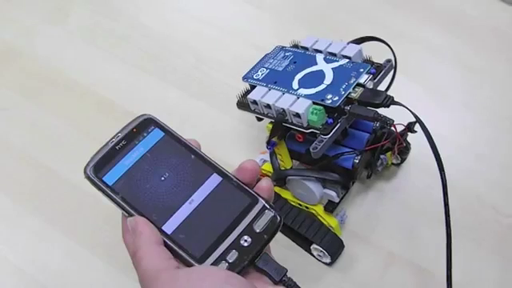
Inspiration
http://youtu.be/hHVM_5KmHdA

Slide 5

Inspiration
http://youtu.be/Ub7newiu930

Slide 6
Live Demo

Slide 7
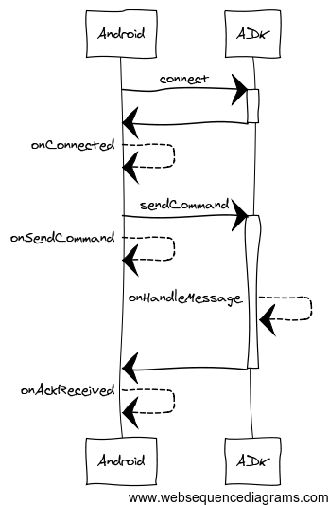
Android-ADK communication protocol

Slide 8
Android-ADK communication protocol
Android Events
onConnected
onDisconnected
onSendCommand
onAckReceived

Slide 9
Android-ADK communication protocol
Android Communication API
sendCommand
Accepts:
byte command
byte action
byte[] data

Slide 10
Android-ADK communication protocol
ADK Events
onHandleMessage
Signature:
byte command
byte action
byte dataLength
byte* data

Slide 11


Resistors
Manage the flow of current through a circuit, creating a drop in voltage between two points

Slide 12
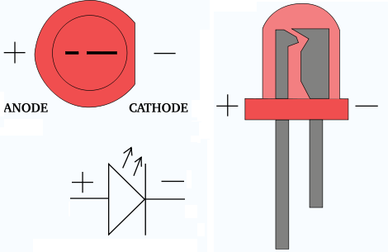
Light Emitting Diodes

Slide 13
Technical environment
Requirements
Android device running 2.3.4 or higher (not all custom ROMs are supported)
USB cable
Laptop with:
Android SDK (including platform 2.3.3, API level or higher)
Arduino IDE for ADK 2011
Arduino IDE for ADK 2012
Arduino libs – copy these libraries to [arduino_installation_folder]/libraries/
Eclipse + Android plugin / Intellij / etc.
Lab’s git repository
https://github.com/amirlazarovich/codelab-adk-leds

Slide 14
Lab Outline
Setting up the environment: Integrated blinking led
Getting to know the Android end: Android controlled switch on/off for the integrated led
Getting to know the ADK end: Controlling an external led
Customizing both ends: Christmas lights

Slide 15
1st milestone (part 1) Integrated Blinking Led
Mission: all teams should be able to communicate with their ADKs
Steps:
git clone git@github.com:amirlazarovich/codelab-adk-leds.git
Copy the Arduino libraries from [cloned directory]/Arduino/libs to [Arduino installation folder]/libraries/
Open the Arduino IDE and select the correct board: tools-board-[Arduino mega 2560 or Mega ADK] or [ADK 2012] (depending on your ADK model)
Now select the correct usb serial-port: tty.usbserial***
Run the example project: file – examples – basics - blink

Slide 16
1st milestone (part 2) Integrated Blinking Led
Mission: all teams should be able to communicate with their ADKs
Steps:
Open Eclipse/Intellij/etc. and import the projects “adk-manager” and “blinking-led”
Make sure the project “blinking-led” import the library project “adk-manager” and uses SDK >= 2.3.3
Install the blinking-led project on your Android device
Open the ADK IDE and run the project Adk_201X_blinking_led

Slide 17
2nd milestone Android Switch
Mission: Getting familiar with the Android end protocol
What you should do: Create a new layout with a Switch/Toggle button/etc. that sends signals to the ADK device to turn the led on/off

Slide 18
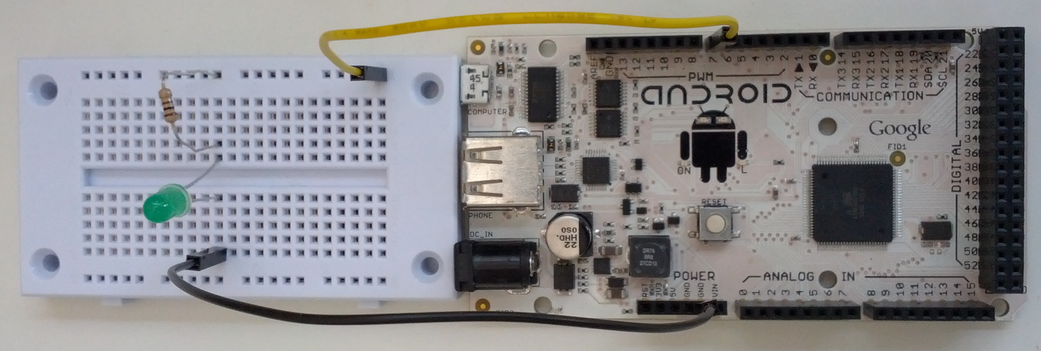
3rd milestone External Led
Mission: Getting familiar with the Arduino end protocol
What you should do: Build a simple electronic circuit and control it with your ADK

Slide 19
Final milestone Christmas lights
Mission: Customize both ends and control multiple LEDs
What you should do: Build any electronic circuit you want that is compiled of LEDs and resistors. Control those LEDs using your Android device in any way you want (switches/automatic timers/sensors/etc.)

Slide 20







Thank you
Our sponsors:

Slide 21

See you at our next Lab

